Slide 1
Pseudocode
When designing an ALGORITHM to solve a problem, Pseudocode, can be used.
  Artificial, informal language used to develop algorithms
  Similar to everyday English
Not executed on computers
  Used to think out program before coding
    Easy to convert into C++ program
  Only executable statements
    No need to declare variables

Slide 2
2.4 Control Structures
Sequential execution
  Statements executed in order
Transfer of control
  Next statement executed not next one in sequence
3 control structures (Bohm and Jacopini)
  Sequence structure
    Programs executed sequentially by default
  Selection structures
    if, if/else, switch
  Repetition structures
    while, do/while, for

Slide 3
2.4 Control Structures
Flowchart
  Graphical representation of an algorithm
  Special-purpose symbols connected by arrows (flowlines)
  Rectangle symbol (action symbol)
    Any type of action
  Oval symbol
    Beginning or end of a program, or a section of code (circles)
Single-entry/single-exit control structures
  Connect exit point of one to entry point of the next
  Control structure stacking

Slide 4
2.5 if Selection Structure
Selection structure
  Choose among alternative courses of action
  Pseudocode example:
      If student’s grade is greater than or equal to 60
      Print “Passed”
  If the condition is true
    Print statement executed, program continues to next statement
  If the condition is false
    Print statement ignored, program continues
  Indenting makes programs easier to read
    C++ ignores whitespace characters (tabs, spaces, etc.)

Slide 5
2.5 if Selection Structure
Translation into C++
      If student’s grade is greater than or equal to 60
      Print “Passed”
      if ( grade >= 60 )
      cout << "Passed";
Diamond symbol (decision symbol)
  Indicates decision is to be made
  Contains an expression that can be true or false
    Test condition, follow path
if structure
  Single-entry/single-exit

Slide 6
2.5 if Selection Structure
Flowchart of pseudocode statement
A decision can be made on any expression.
zero - false
nonzero - true
Example:
3 - 4 is true
true
grade >= 60
print “Passed”
false

Slide 7
2.6 if/else Selection Structure
if
  Performs action if condition true
if/else
  Different actions if conditions true or false
Pseudocode
    if student’s grade is greater than or equal to 60
    print “Passed”
    else
    print “Failed”
C++ code
    if ( grade >= 60 )
    cout << "Passed";
    else
    cout << "Failed";

Slide 8
2.6 if/else Selection Structure
Ternary conditional operator (?:)
  Three arguments (condition, value if true, value if false)
Code could be written:
cout << ( grade >= 60 ? “Passed” : “Failed” );
Condition
Value if true
Value if false
false
true
grade >= 60
print “Failed”
print “Passed”

Slide 9
2.6 if/else Selection Structure
Nested if/else structures
  One inside another, test for multiple cases
  Once condition met, other statements skipped
  if student’s grade is greater than or equal to 90
  Print “A”
  else
  if student’s grade is greater than or equal to 80
  Print “B”
  else
  if student’s grade is greater than or equal to 70
  Print “C”
  else
  if student’s grade is greater than or equal to 60
  Print “D”
  else
    Print “F”

Slide 10
2.6 if/else Selection Structure
Example
if ( grade >= 90 ) // 90 and above
cout << "A";
else if ( grade >= 80 ) // 80-89
cout << "B";
else if ( grade >= 70 ) // 70-79
cout << "C";
else if ( grade >= 60 ) // 60-69
cout << "D";
else // less than 60
cout << "F";

Slide 11
2.6 if/else Selection Structure
Compound statement
  Set of statements within a pair of braces
  if ( grade >= 60 )
  cout << "Passed.\n";
  else {
  cout << "Failed.\n";
  cout << "You must take this course again.\n";
  }
  Without braces,
  cout << "You must take this course again.\n";
  always executed
Block
  Set of statements within braces

Slide 12
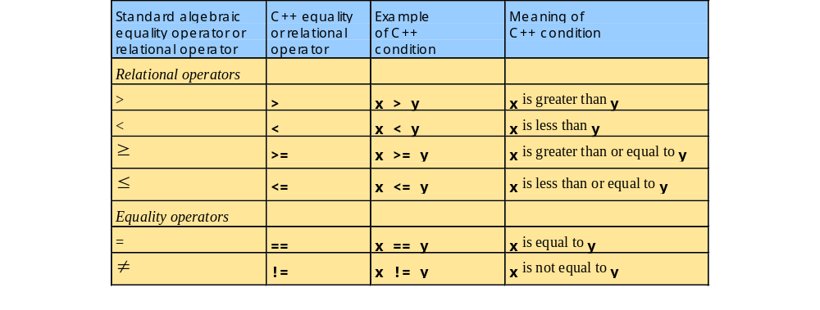
1.25 Decision Making: Equality and Relational Operators

Slide 13
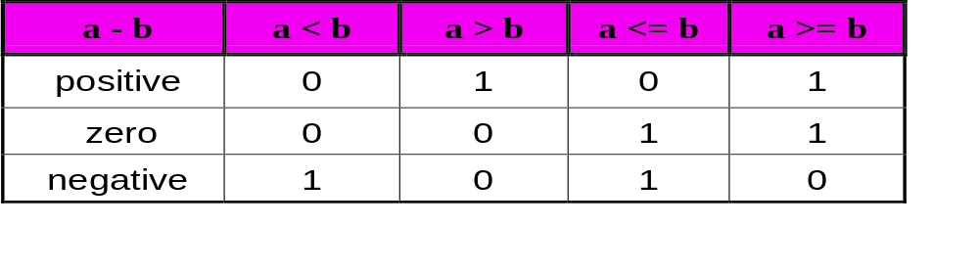
Values of Relational Expressions

Slide 14
Equality Operators Exmaples
  Valid
  -----------------------------------------
  c == ‘A’
  k != -2
  y == 2 * z – 5
  Not Valid
  ----------------------------------------
  a = b // assignment statement
  a = = b – 1 // space not allowed
  y =! z // this is equivalent to y = (!z)

Slide 15
Numerical Accuracy
Many decimal numbers cannot be exactly represented in binary by a finite number of bits. Thus testing for exact equality can fail.
Use the technique:
|operand1 - operand2| < epsilon
Ex. x/y == 17
abs(x/y - 17) < 0.000001
*

Slide 16
Logical Operators
Negation (unary) !
Logical and &&
Logical or ||
*

Slide 17
Logical Operators: Examples
Valid
(a < 9) && (b> 7)
((a< 6) || (b > 8)) && (c< 7)
!(a < b) && c > k
3 && (-2 * a + 7)
Not Valid
a > l && // one operand missing
a>9 | | b <m // extra space not allowed
a> 9 & b<8 // this is a bitwise operation
&b // the address of b
* *

Slide 18
Logical Operators: Examples
int a = 0, b = 3, c = 1, d =4;
a && !c || d
F
b
b
F
b
T
* * *

Slide 19
Logical Operators
Expression
Expression Equivalent
!(a == b)
!(a == b || a == c)
!(a == b && c > d)
a != b
a != b && a != c
a != b || c <= d
* * *

Slide 20
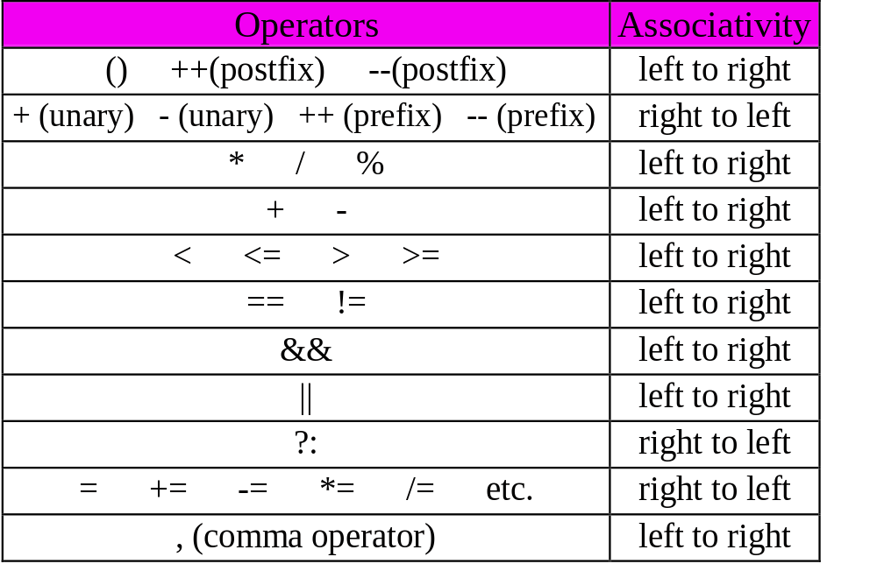
Operator Precedence and Associativity
not
!
arithmetic
relational
logical

Slide 21
The Empty Statement
The empty statement is written as a semicolon.
Example:
; // an empty statement
Other statements:
a = b; // an assignment statement
a + b + c; // legal, no useful work done
cout << a() << "\n"; // a function call

Slide 22
Common Errors!
= = means equality
= used for assignment
FALSE is zero
TRUE is nonzero
Boolean operators give a Boolean result
* *

Slide 23
2.16 switch Multiple-Selection Structure
switch
  Test variable for multiple values
  Series of case labels and optional default case
switch ( variable ) {
case value1: // taken if variable == value1
statements
break; // necessary to exit switch
case value2:
case value3: // taken if variable == value2 or == value3
statements
break;
default: // taken if variable matches no other cases
statements
break;
}

Slide 24
2.16 switch Multiple-Selection Structure
case a
true
case a action(s)
break
false
case b
true
case b action(s)
break
false
.
.
.
case z
true
case z action(s)
break
false
default action(s)

Slide 25
The switch Statement
Syntax switch (expression)
{
case value1:
statement1;
break;
case value2:
statement2;
break;
• • •
case valuen:
statementn;
break;
default:
statement;
}
no ;
use :
* *

Slide 26
The switch Statement
Syntax switch (expression)
{
case value1:
statement1;
break;
case value2:
statement2;
break;
• • •
case valuen:
statementn;
break;
default:
statement;
}
no ;
use :

Slide 27
char let_grd;
cout <<“Please type in your grade”<<endl;
cin >> let_grd;
switch (let_grd)
{
case ‘A’:
cout << “Congratulations!”;
break;
case ‘B’:
cout << “Good job!”;
break;
case ‘C’:
cout << “ok, but you can do better!”;
break;
cont.

Slide 28
The switch Statement
case ‘D’:
cout << “Better luck in PMII”;
break;
case ‘F’:
cout << “ Have fun in summer school!”;
break;
default:
cout << “You entered an invalid grade.”;
}
next statement

Slide 29
The switch and Break Statement
switch (let_grd)
{
case ‘A’:
cout << “Congratulations!”;
break;
case ‘B’:
cout << “Good Job!”;
break;
case ‘C’:
cout << “OK, but you can do better!”;
break;
case ‘D’:
cout << “Better luck in PMII!”;
break;
case ‘E’:
cout << “Have fun in summer school!”;
break;
default:
cout << “You entered an invalid grade.”;
}

Slide 30
The break Statement
switch (let_grd)
{
case ‘A’:
case ‘B’: cout << “Good Work”;
break;
case ‘C’: cout << “ok!”;
break;
case ‘D’:
case ‘E’: cout << “Have fun in summer school!”;
}

Slide 31
The break Statement
switch (let_grd)
{
case ‘A’:
case ‘a’:
case ‘B’:
case ‘b’: cout << “Good Work”;
break;
case ‘C’:
case ‘c’: cout << “OK!”;
break;
etc.

